Slide 1
RNA Secondary Structure
Prediction
● Using Context Free Grammars ●
Ali Ahmadi Esfidi

Slide 2
01
Abstract
What We’re gonna do
02
Secondary Structure
What is RNA Secondary Structure
CONTENTS
03
Substitution Models
Steps to undrestand this prediction method
Fast over-view on substitution models specially general reversable models
04
Context Free Grammar
All wee need to know about context free grammars
05
Check Full Model
Explain and test the full model

Slide 3
01
Abstract
What We’re gonna do

Slide 4
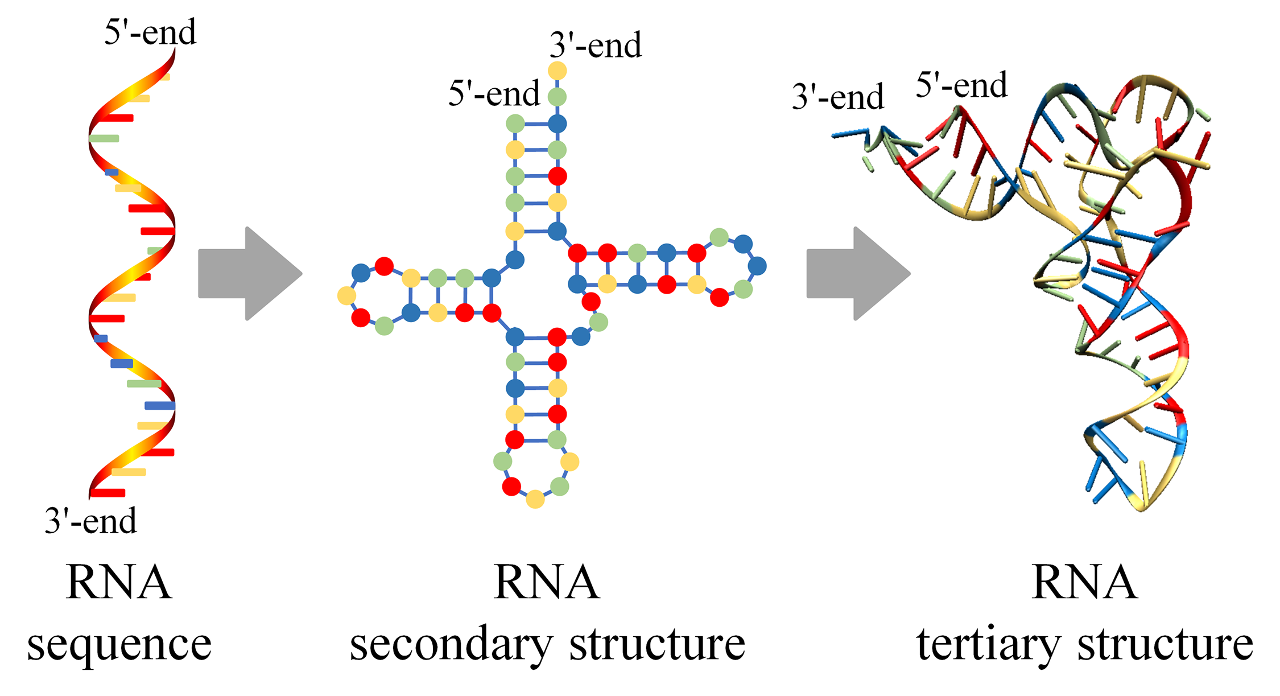
RNA Secondary Structure

Slide 5
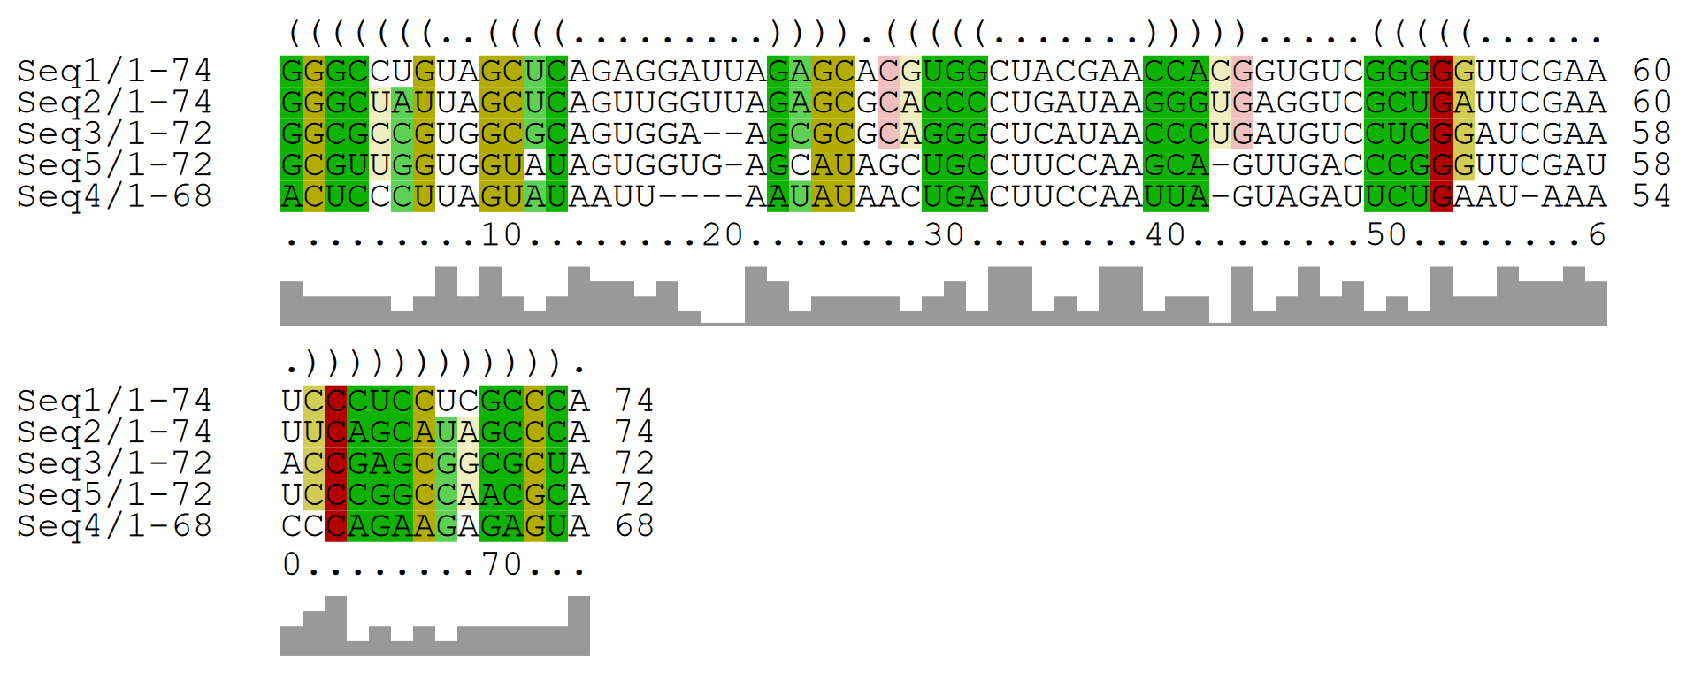
Input And Output

Slide 6
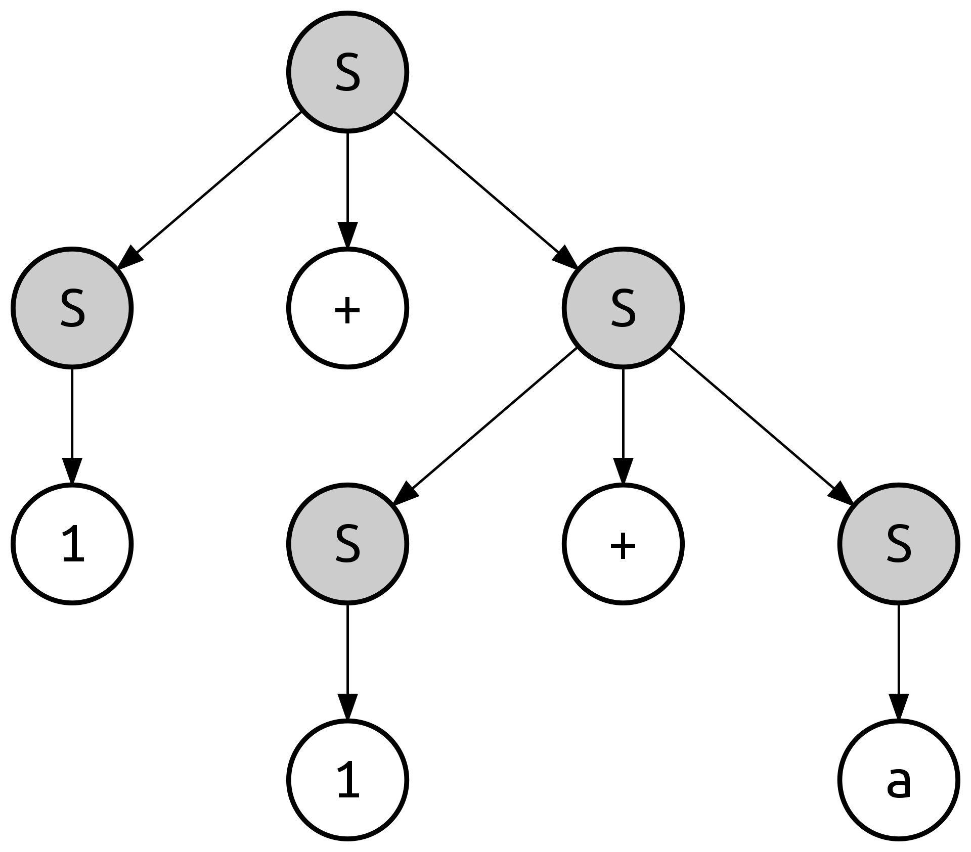





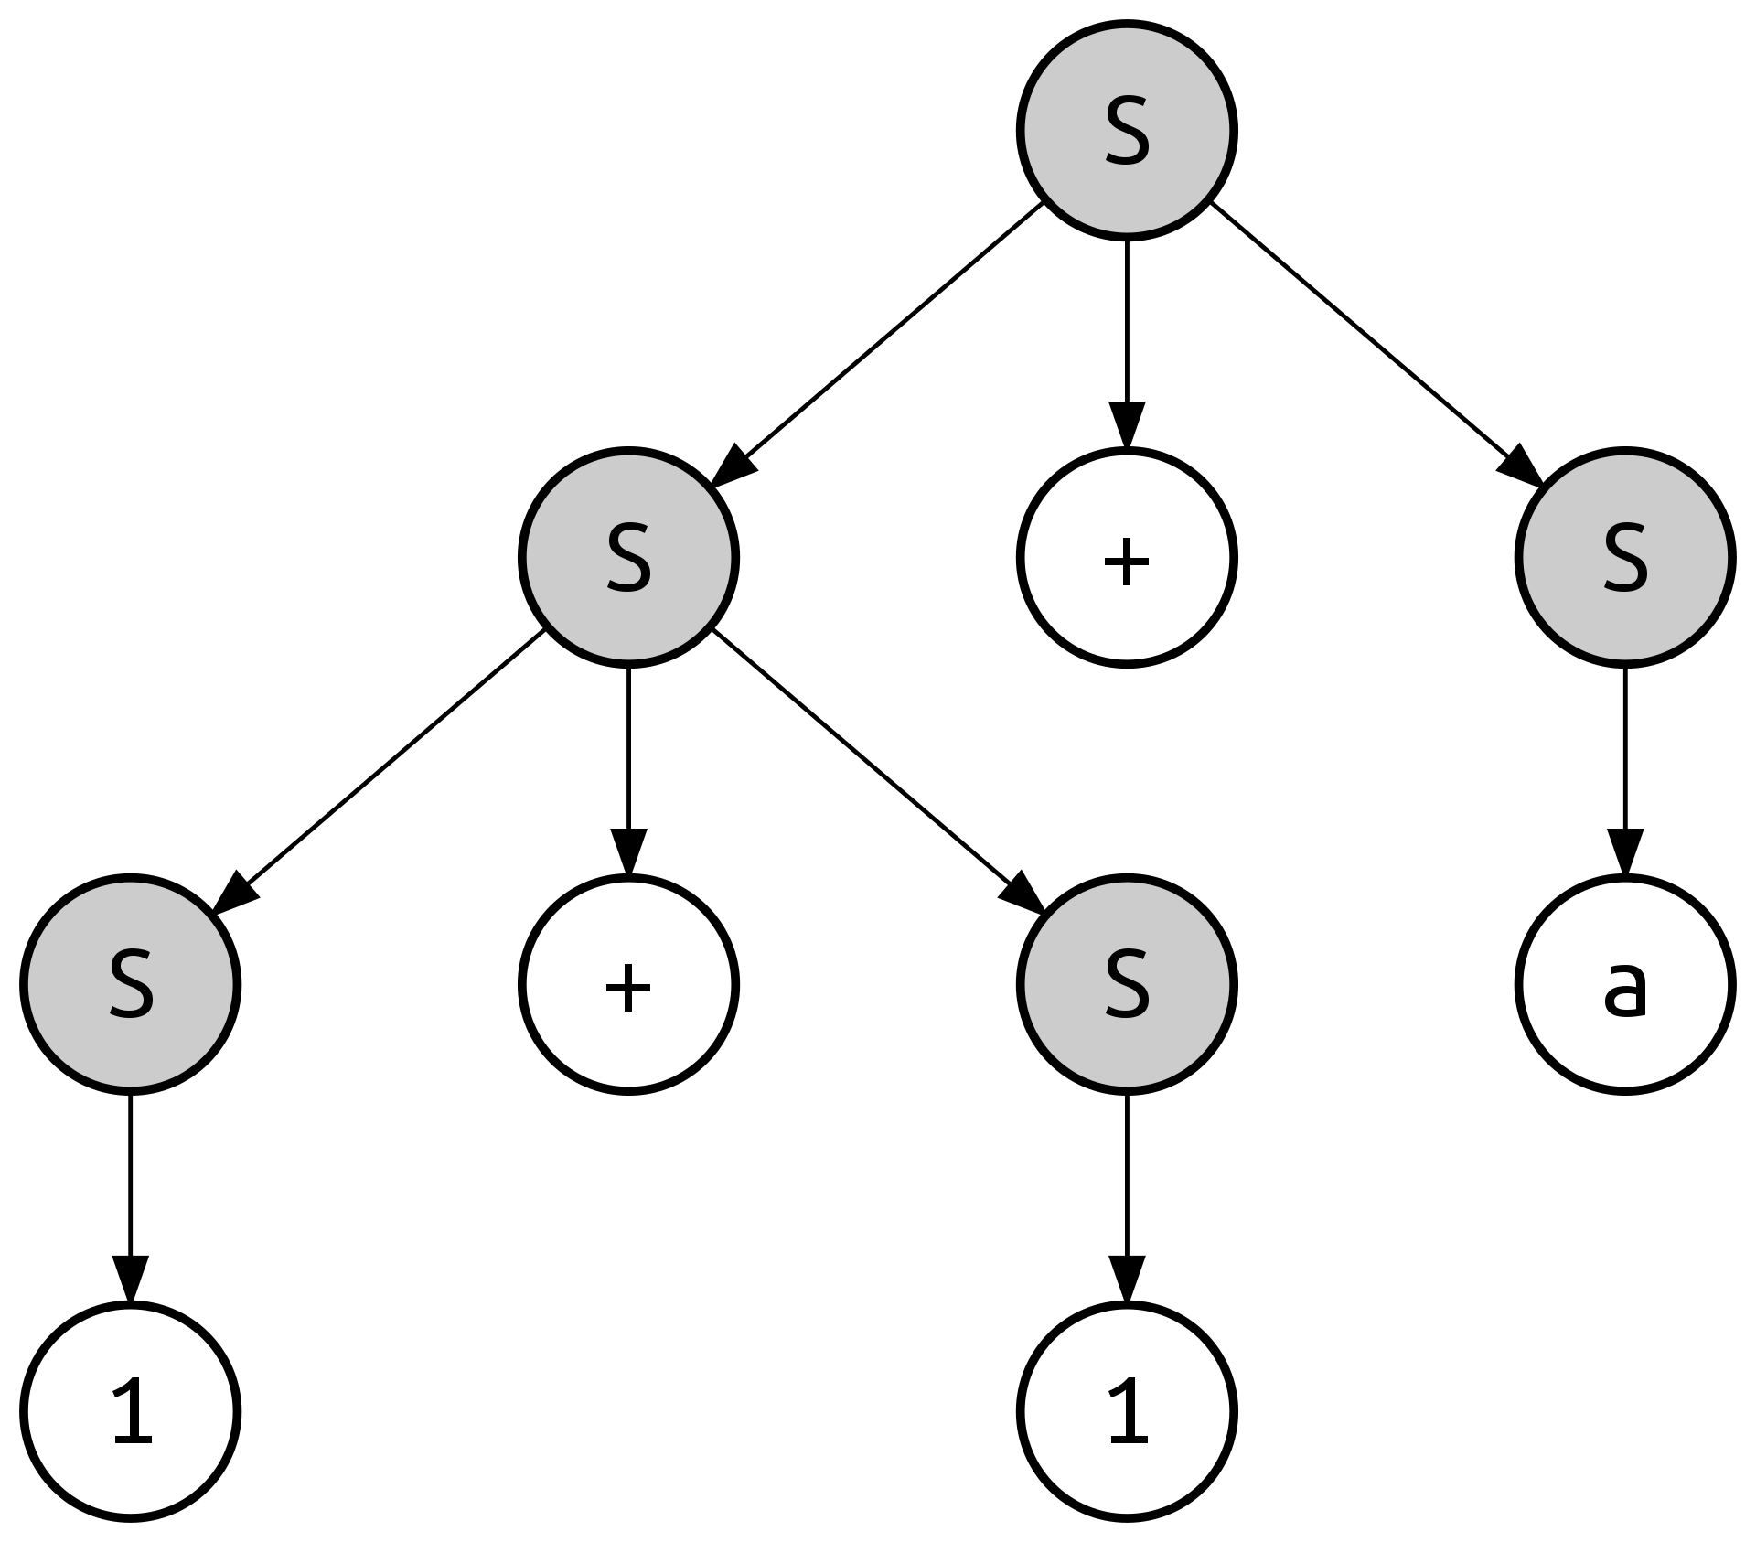

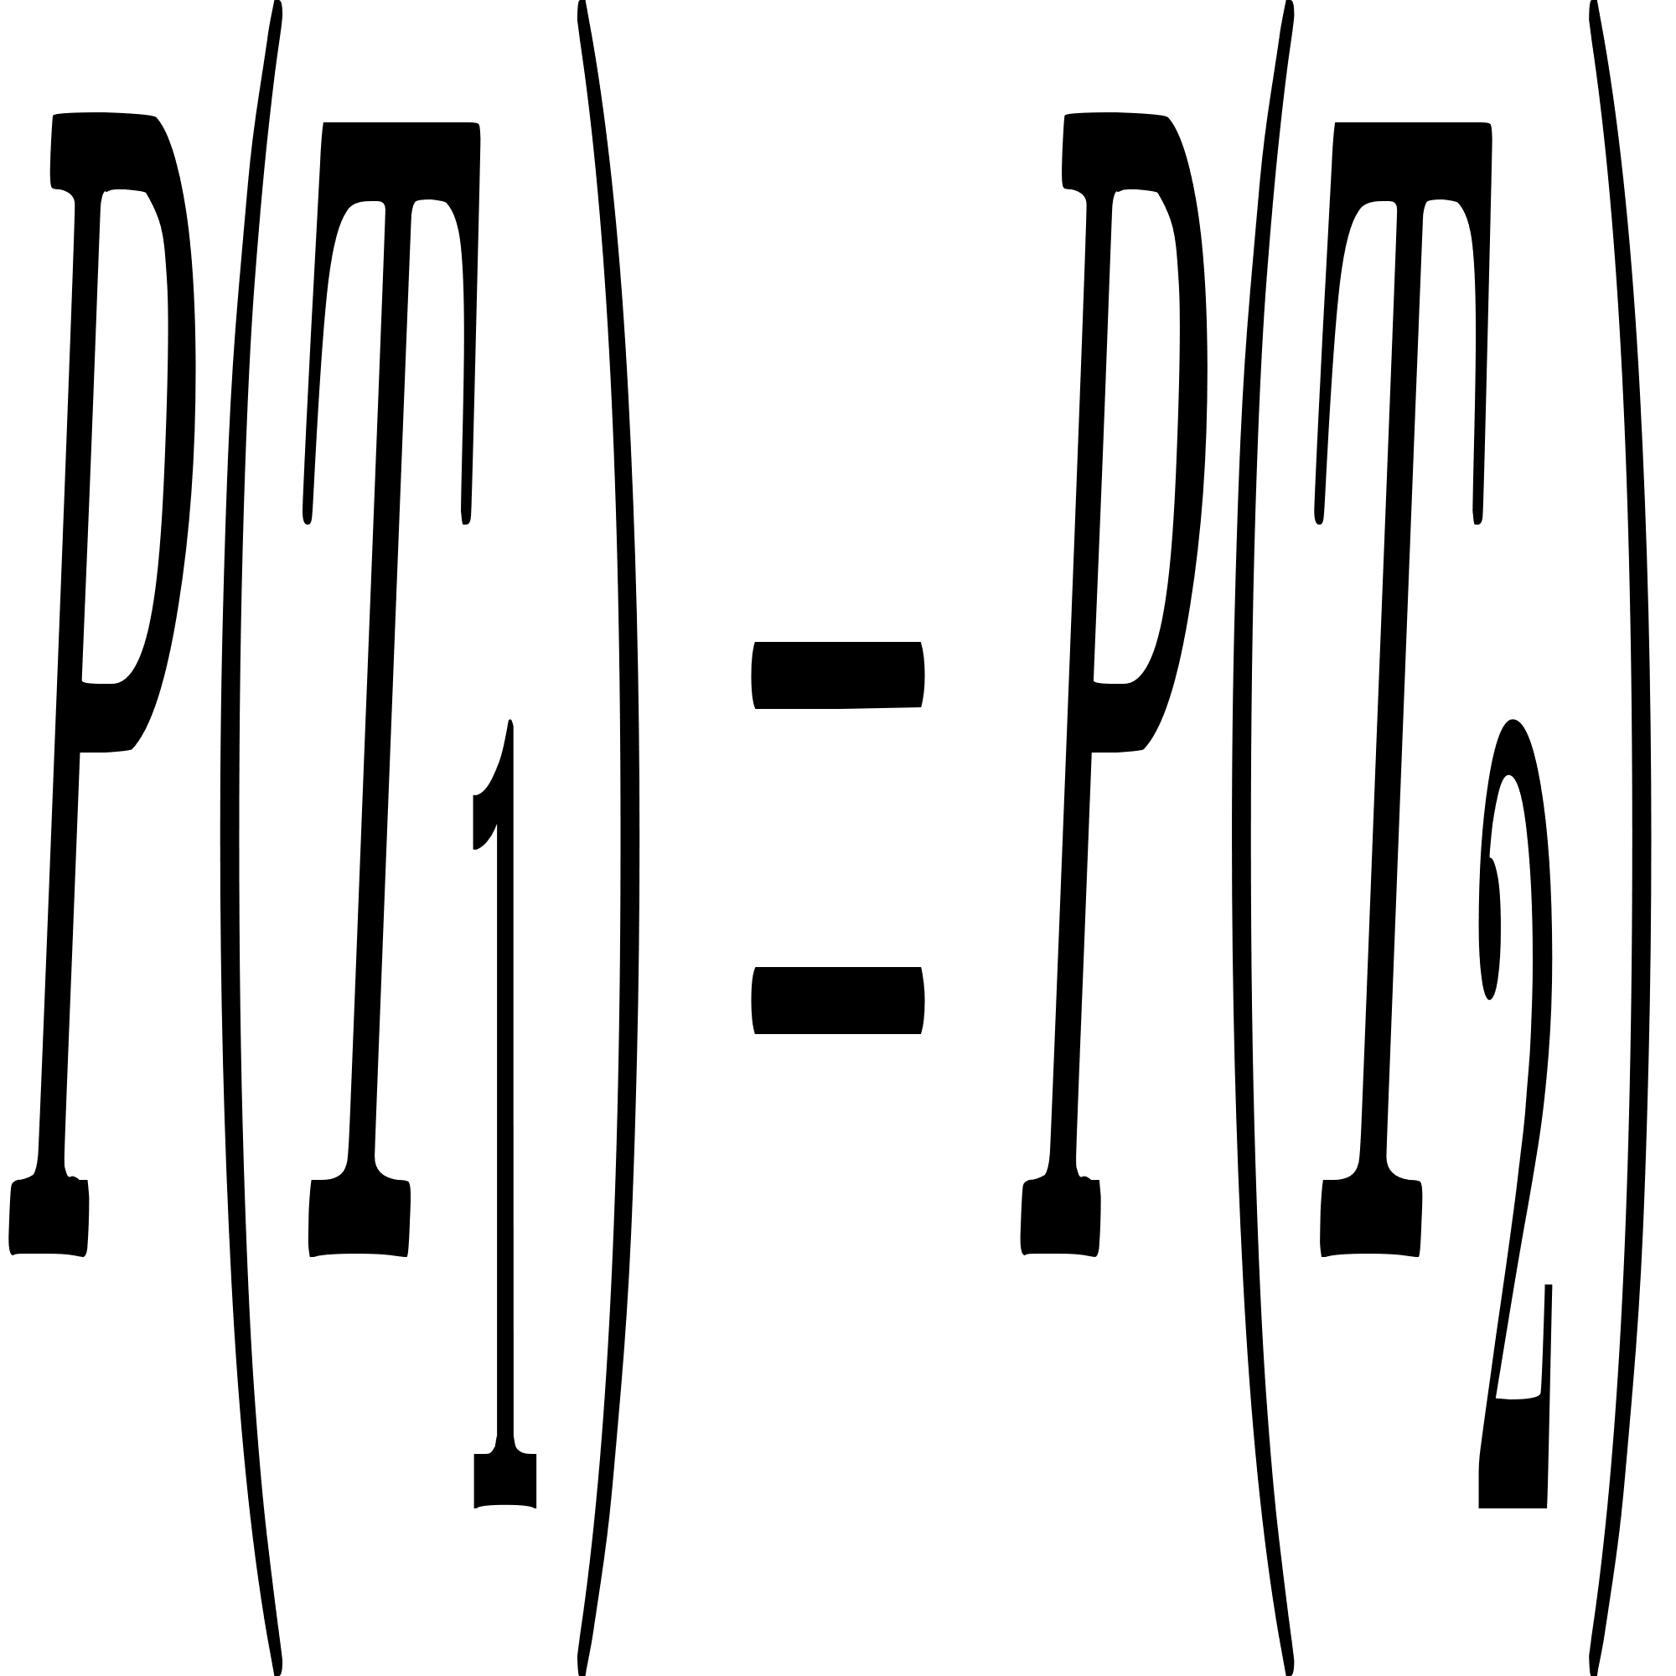
Stochastic Context Free Grammar
+ P
60%
30%
10%
= 0.6 * 0.6 * 0.3 * 0.3 * 0.1
Not Always true in PCFG :)

Slide 7
Back To Problem
A
A
A
A
A
A
A
A
A
C
A
A
A
A
G
A
A
A
A
U
A
A
A
C
A
What are terminals?!
...
So, we need to calculate all possible columns probablity, in two state of being single base or pair base.

Slide 8
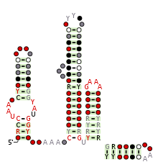

Primary Data Used
Family name : LOOT (RF03000)
Number of taxa : 368
Number of sites : 203

Slide 9
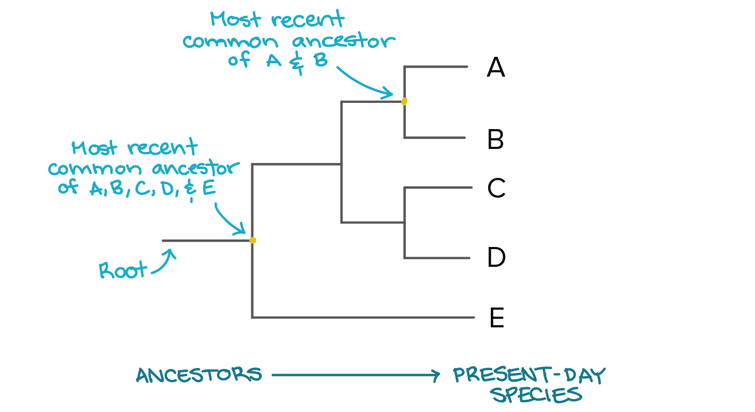
Phylogenetic Tree (For column probablity)

Slide 10
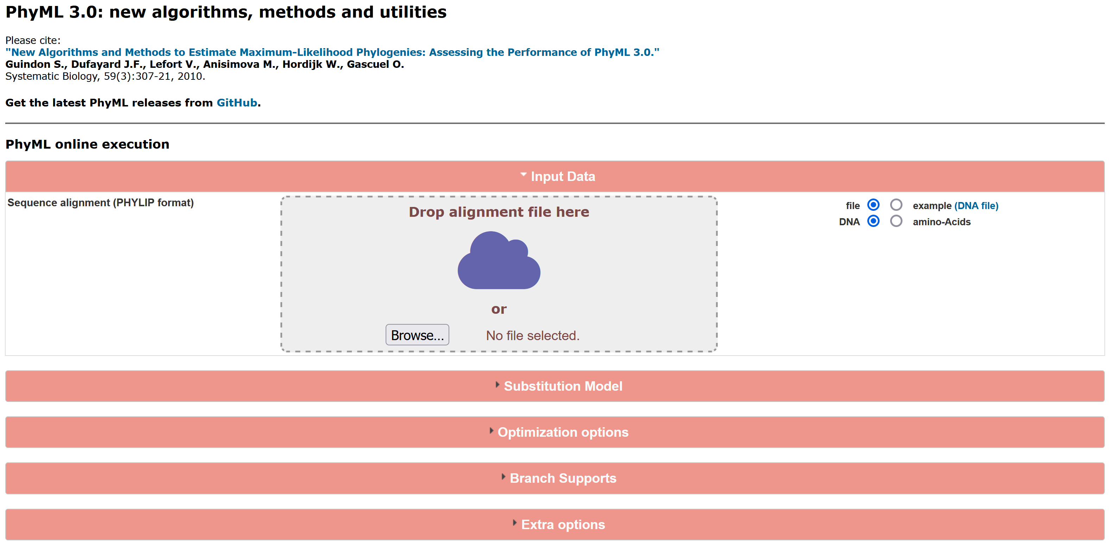
Phylogenetic Tree (For column probablity)

Slide 11
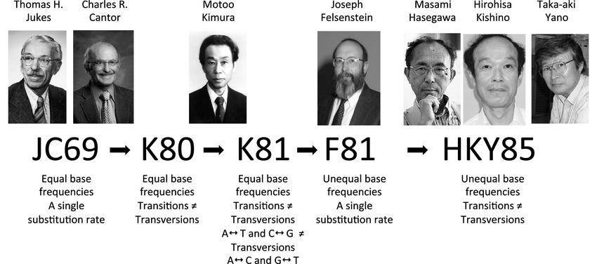
Substitution Models

Slide 12
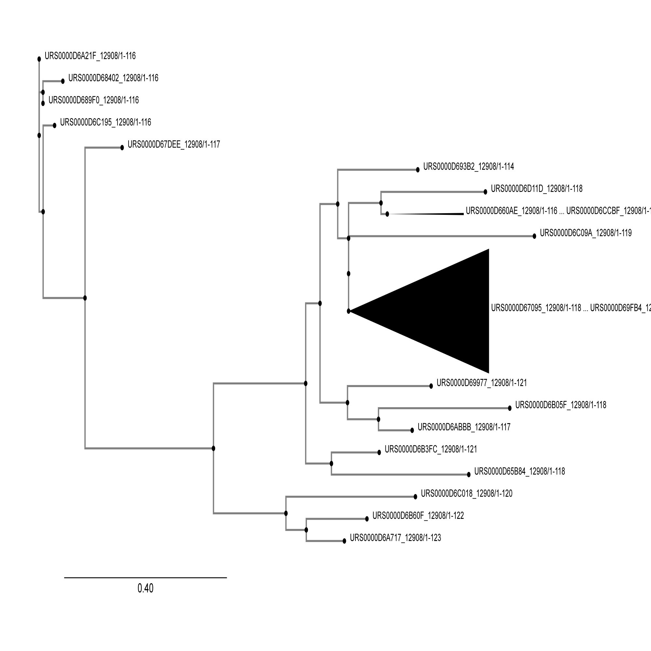
Tree Of Primary Data

Slide 13
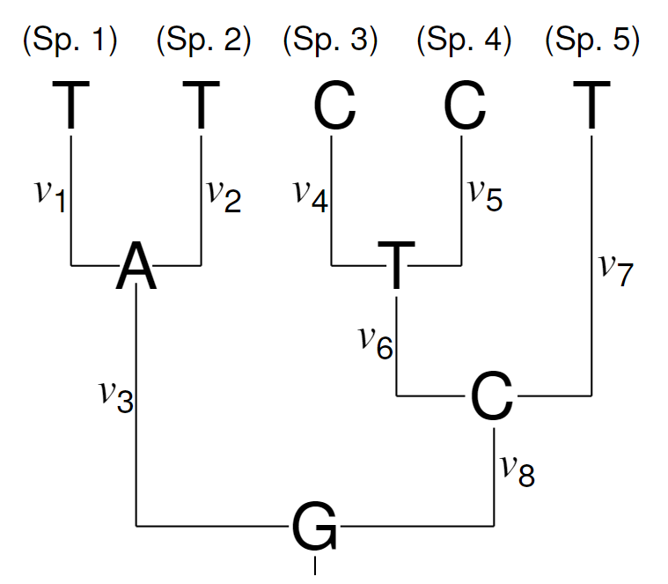
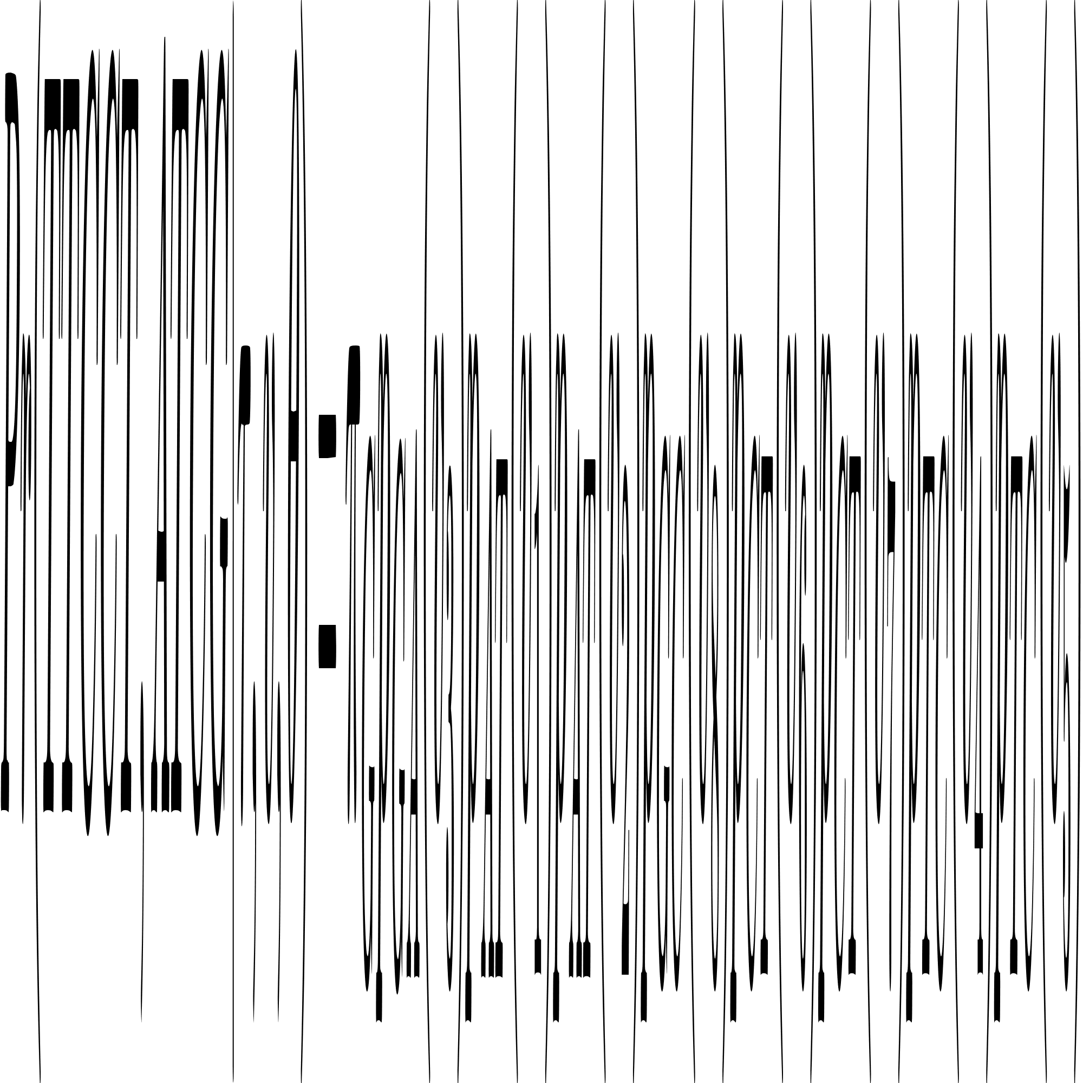
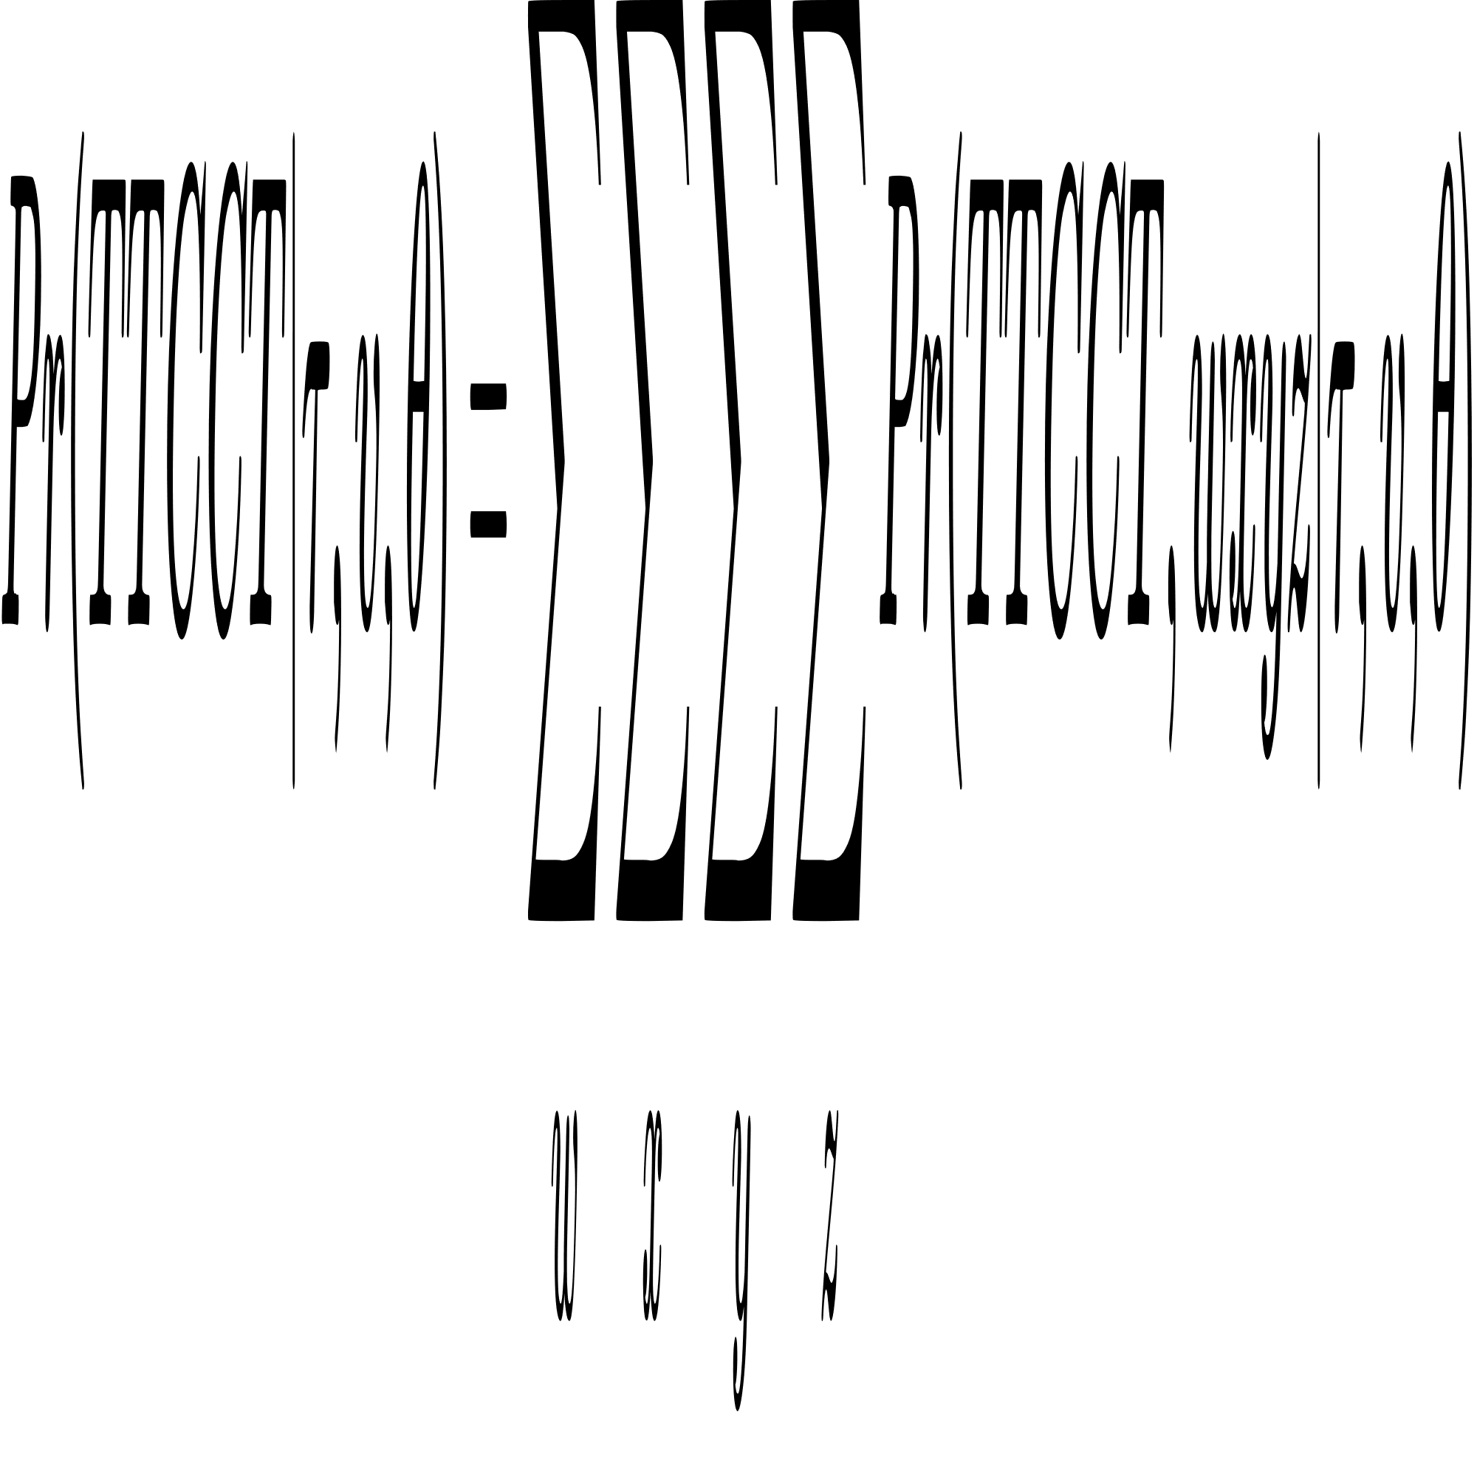
Column Probablity

Slide 14
Calculating Frequencies (π)
Single Bases:
Counting A, C, G and U, and finding each ratio to all single bases.
Pair Bases:
Counting AA, AC, AG, AU and ... and finding each ratio to all pair bases.

Slide 15
03
Substitution Models
Fast over-view on substitution models specially general reversable models

Slide 16
Substitution Models
PhyML is a software package that uses modern statistical approaches to analyse alignments of nucleotide or amino acid sequences in a phylogenetic framework. The main tool in this package builds phylogenies under the maximum likelihood criterion. It implements a large number of substitution models coupled to efficient options to search the space of phylogenetic tree topologies.

Slide 17
04
Context Free Grammar
All wee need to know about context free grammars

Slide 18
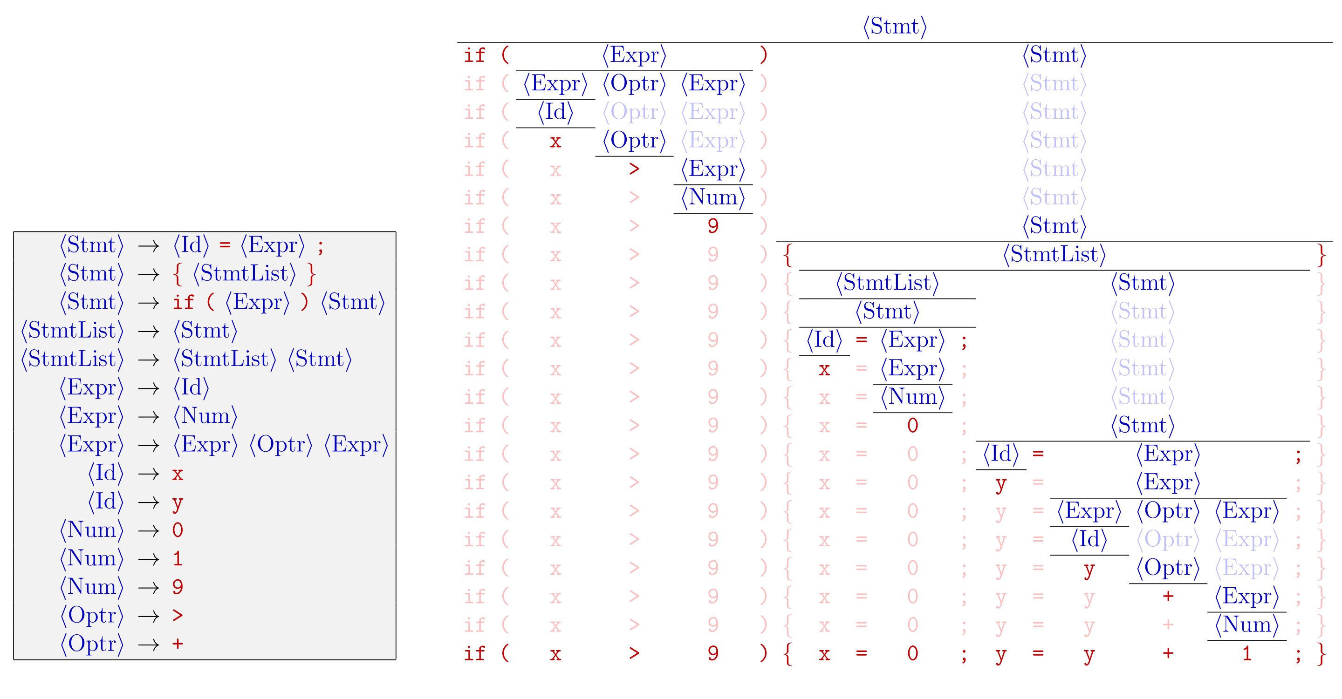
Context Free Grammar
A grammar consists of a set of variables, some terminal and some non-terminal. Specifically, a starting non-terminal called S is contained in a grammar. The non-terminals are rewritten according to a set of production rules, which specifies a single non-terminal and a string of variables, that it should be changed to. Successive production rules are applied until only a string of terminals are left.

Slide 19
Context Free Grammar
A stochastic context-free grammar (SCFG), also known as a probabilistic context-free grammar (PCFG), is a type of context-free grammar where each production rule is associated with a probability.
SCFGs find applications in two main areas:
Natural Language Processing (NLP)
RNA Secondary Structure Analysis

Slide 20
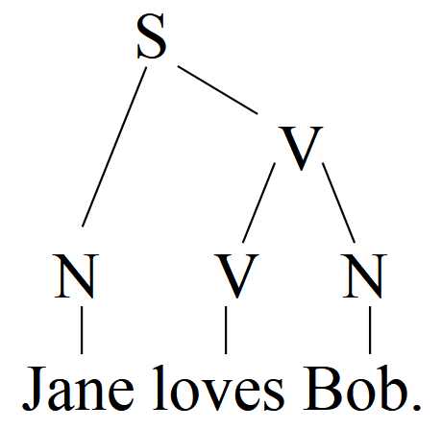
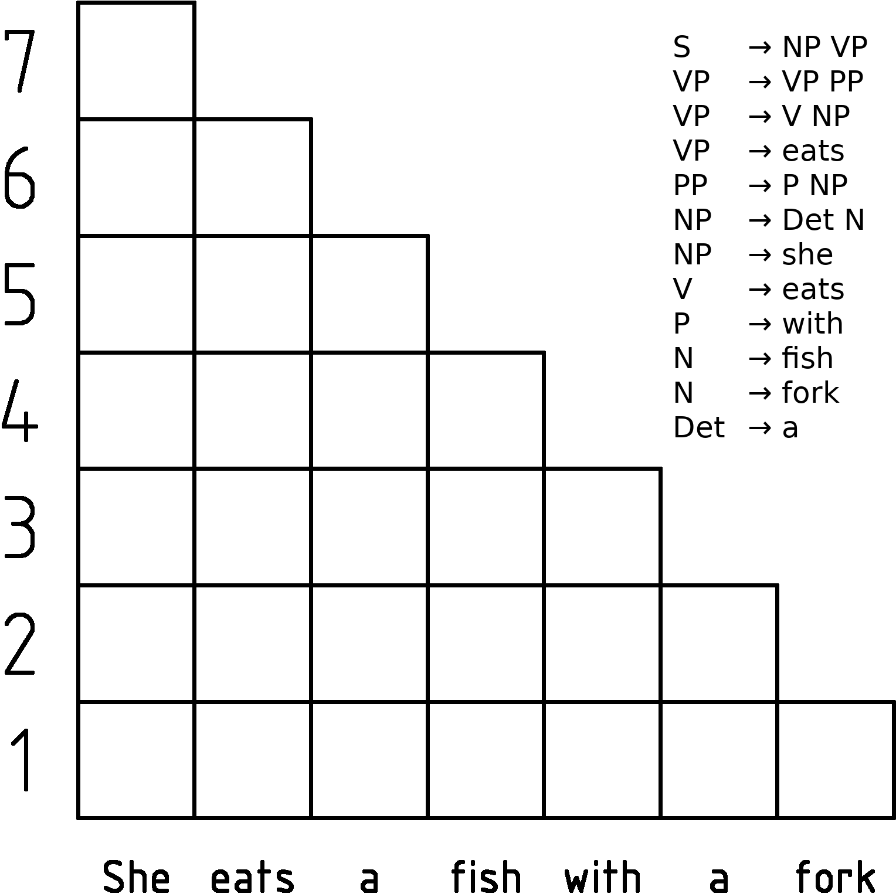
Context Free Grammar
Three important algorithms are encountered with SCFGs:
CYK Algorithm: The CYK algorithm is a parsing algorithm for context-free grammars. It uses a dynamic programming approach to solve the membership problem, which is to determine whether a given string is a member of a language generated by a given grammar.
The Probabilistic CYK algorithm is a variant of the CYK algorithm used for finding the most probable parse of a sentence given a probabilistic context-free grammar.

Slide 21
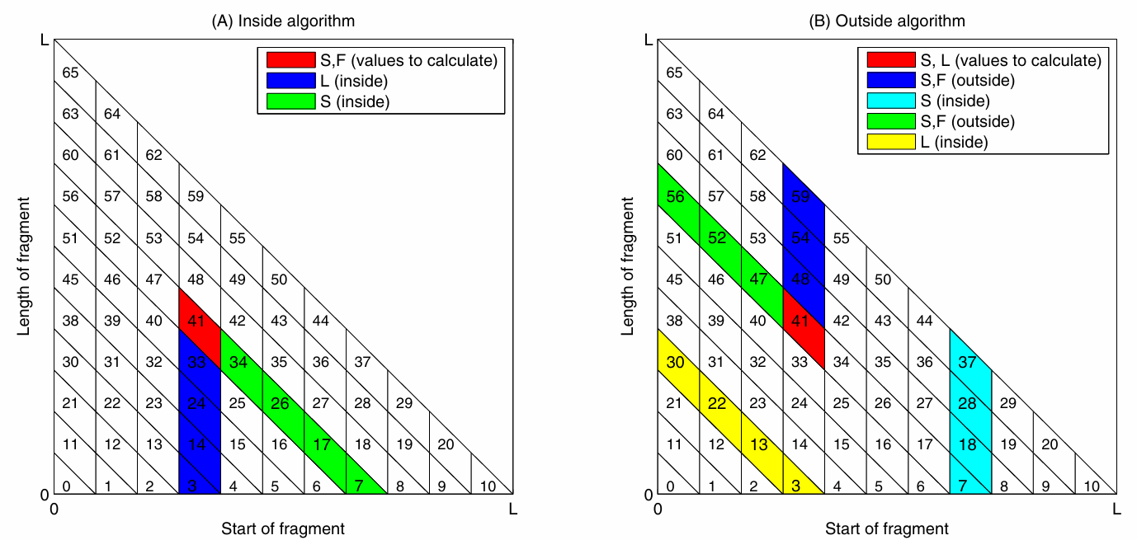
Context Free Grammar
Inside Algorithm: The Inside algorithm calculates the total probability of generating a sequence of words given a root nonterminal and a grammar. It’s used to compute the sum of potentials for all trees spanning a certain range of words, rooted in a specific symbol. This is crucial in re-estimating production probabilities in a PCFG.
Outside Algorithm: The Outside algorithm, on the other hand, calculates the total probability of beginning with the start symbol and generating a nonterminal and all the words outside a certain range, given a grammar. It computes the sum of the left and right contributions over all possible rules. This is also used in re-estimating production probabilities in a PCFG.
Both these algorithms are used in EM estimation of PCFGs and in estimation of discriminative models for context-free parsing. They were introduced as a generalization of the forward-backward algorithm for parameter estimation on hidden Markov models.

Slide 22


Enter title
We Help You Make You Report Easy And Fast!
Enter title
This Template Is Designed By Zuo An,It Will Help You Make You Report Easy And Fast.
This Template Is Designed By Zuo An,It Will Help You Make You Report Easy And Fast. This Template Is Designed By Zuo An,It Will Help You Make You Report Easy And Fast.

Slide 23
Enter title
We Help You Make You Report Easy And Fast!
Enter title
Enter title
This Template Is Designed By Zuo An,It Will Help You Make You Report Easy And Fast.
This Template Is Designed By Zuo An,It Will Help You Make You Report Easy And Fast.
80%
80%
58%
58%
76%
76%
80%
80%
58%
58%

Slide 25



Enter title
We Help You Make You Report Easy And Fast!
Enter title
Enter title
Enter title
This Template Is Designed By Zuo An,It Will Help You Make You Report Easy And Fast.
This Template Is Designed By Zuo An,It Will Help You Make You Report Easy And Fast.
This Template Is Designed By Zuo An,It Will Help You Make You Report Easy And Fast.

Slide 26




Enter title
Enter title
Help You Make You Report Easy And Fast.
Help You Make You Report Easy And Fast.
Enter title
Enter title
Help You Make You Report Easy And Fast.
Help You Make You Report Easy And Fast.

Slide 27
Enter title
We Help You Make You Report Easy And Fast!
Enter title
Enter title
Enter title
Help You Make You Report Easy And Fast.
Help You Make You Report Easy And Fast.
Help You Make You Report Easy And Fast.
Enter title
Enter title
Enter title
80%
80%
80%
Enter title
Enter title
Enter title
58%
58%
58%
Enter title
Enter title
Enter title
76%
76%
76%

Slide 28




Enter title
We Help You Make You Report Easy And Fast!
Enter title
Enter title
Help You Make You Report Easy And Fast.
Help You Make You Report Easy And Fast.
Enter title
Enter title
Help You Make You Report Easy And Fast.
Help You Make You Report Easy And Fast.

Slide 29
Enter title
We Help You Make You Report Easy And Fast!
Enter title
Enter title
Enter title
Enter title
This Template Is Designed By Zuo An,It Will Help You Make You Report Easy And Fast.
This Template Is Designed By Zuo An,It Will Help You Make You Report Easy And Fast.
This Template Is Designed By Zuo An,It Will Help You Make You Report Easy And Fast.
This Template Is Designed By Zuo An,It Will Help You Make You Report Easy And Fast.

Slide 30
Enter title
We Help You Make You Report Easy And Fast!
Enter title
Enter title
This Template Is Designed By Zuo An,It Will Help You Make You Report Easy And Fast.
This Template Is Designed By Zuo An,It Will Help You Make You Report Easy And Fast.
Enter title
Enter title
This Template Is Designed By Zuo An,It Will Help You Make You Report Easy And Fast.
This Template Is Designed By Zuo An,It Will Help You Make You Report Easy And Fast.

Slide 31
Enter title
We Help You Make You Report Easy And Fast!
Enter title
Help You Make You Report Easy And Fast.
Enter title
Help You Make You Report Easy And Fast.
Enter title
Help You Make You Report Easy And Fast.
Enter title
Help You Make You Report Easy And Fast.

Slide 32
Enter title
We Help You Make You Report Easy And Fast!
Enter title
Enter title
Enter title
Designed By Zuo An,It Will Help You Make You Report Easy And Fast.
Designed By Zuo An,It Will Help You Make You Report Easy And Fast.
Designed By Zuo An,It Will Help You Make You Report Easy And Fast.
Enter title
Enter title
Enter title
Designed By Zuo An,It Will Help You Make You Report Easy And Fast.
Designed By Zuo An,It Will Help You Make You Report Easy And Fast.
Designed By Zuo An,It Will Help You Make You Report Easy And Fast.

Slide 33
04
Enter title
This Template Is Designed By Zuo An,It Will Help You Make You Report Easy And Fast.

Slide 34
Enter title
We Help You Make You Report Easy And Fast!
Enter title
This Template Is Designed By Zuo An,It Will Help You Make You Report Easy And Fast.
Enter title
This Template Is Designed By Zuo An,It Will Help You Make You Report Easy And Fast.
Enter title
This Template Is Designed By Zuo An,It Will Help You Make You Report Easy And Fast.

Slide 35
Enter title
We Help You Make You Report Easy And Fast!
Enter title
Help You Make You Report Easy And Fast.
Enter title
Help You Make You Report Easy And Fast.
Enter title
Help You Make You Report Easy And Fast.
Enter title
Help You Make You Report Easy And Fast.

Slide 36
Enter title
We Help You Make You Report Easy And Fast!
01
Enter title
Help You Make You Report Easy And Fast.
02
Enter title
Help You Make You Report Easy And Fast.
03
Enter title
Help You Make You Report Easy And Fast.
04
Enter title
Help You Make You Report Easy And Fast.

Slide 37
Enter title
We Help You Make You Report Easy And Fast!
Enter text
Enter text
Enter text
10
20
50
$
$
$
/month
/month
/month
1 GB Bandwith
10 GB Bandwith
Unlimited Bandwith
10 MB Ma9 File Size
50 MB Ma9 File Size
No Ma9imum File Size
3 GHZ CPU
5 GHZ CPU
8 GHZ CPU
2 GB Memory
4 GB Memory
30 GB Memory
Enter text
Enter text
Enter text

Slide 38
Enter title
We Help You Make You Report Easy And Fast!
CEO
Answer A
Answer B
Answer C
Answer A1
Answer A2
Answer B1
Answer B2
Answer C1
Answer C2

Slide 39
Enter title
We Help You Make You Report Easy And Fast!
01
Enter title
This Template Is Designed By Zuo An,It Will Help You Make You Report Easy And Fast.
02
Enter title
This Template Is Designed By Zuo An,It Will Help You Make You Report Easy And Fast.
03
Enter title
This Template Is Designed By Zuo An,It Will Help You Make You Report Easy And Fast.

Slide 40
202X
THANK YOU
● Enter title ●
This Template Is Designed By Zuo An,it Will Help You Make You Report Easy And Fast. We Hope You Have A Wonderful Report！

